Slide 1

D. Y. Patil College of Engineering Akurdi, Pune
Presentation for BE Mini Project
Mushroom Classification
Guide:
Mr. Pramod Deshmukh
Students Name:
Vikas Mane (B1921152)
Abhijeet Bhalekar(B1921155)

Slide 2
Index
Introduction
Problem Statement and Objectives
Methodology
Result
References

Slide 3
Introduction
Data Mining is a process of extracting useful information from data warehouses or from bulk data. This article contains the Most Popular and Frequently Asked Interview Questions of Data Mining along with their detailed answers. These will help you to crack any interview for a data scientist job. So let’s get started.
The following activities are carried out during data mining:
Classification
Clustering
Association Rule Discovery
Sequential Pattern Discovery
Regression
Deviation Detection
In this project we are classifying all the types of mushrooms though the data mining techniques

Slide 4
Problem statement
Classifying the categories of mushroom using data mining techniques

Slide 5
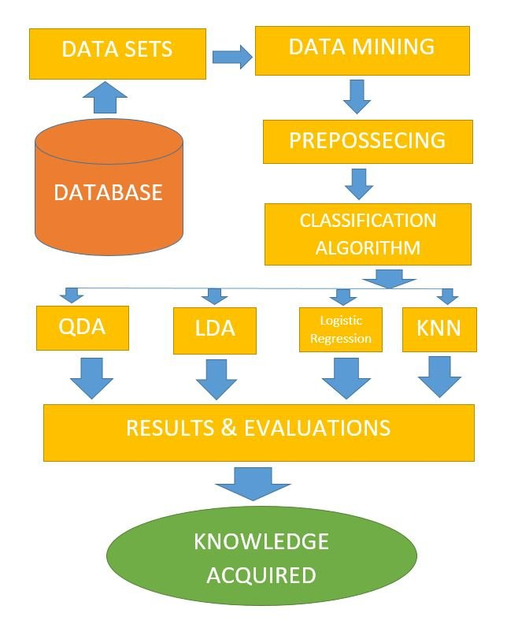
Methodology

Slide 6
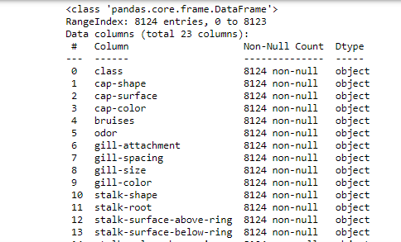
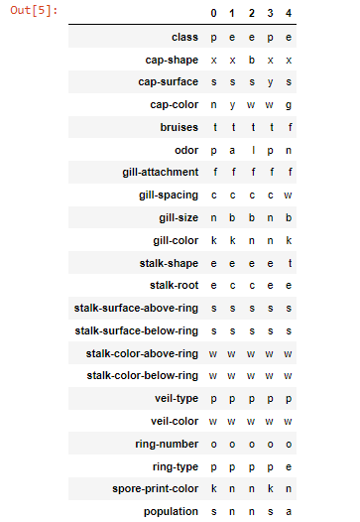
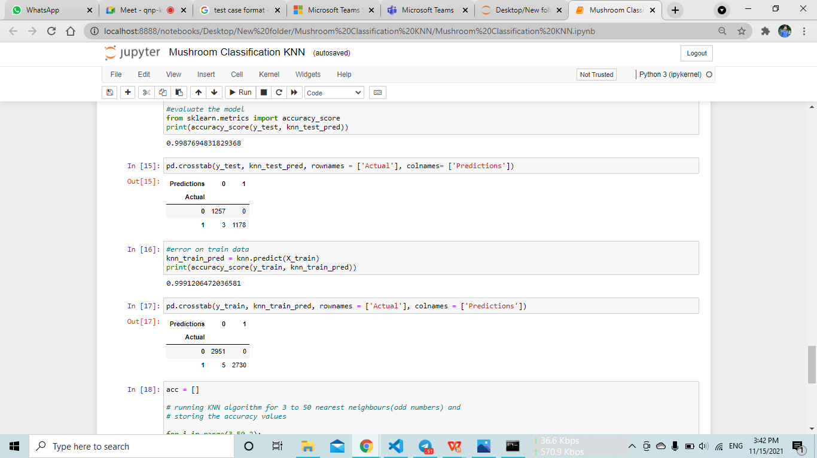
Output
2.First five rows of dataset
1.Mushroom data analysis

Slide 7
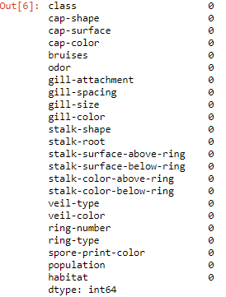
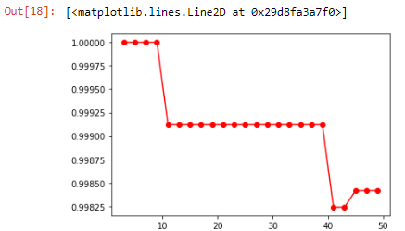
Output
3. Checking for null values
4. Accuracy graph

Slide 8
References
R. Agrawal and R. Srikant, Fast Algorithms for Mining Association Rules (1994) Proc. 20th Int. Conf. Very Large Data Bases, VLDB-94.
Bayardo, R. and R. Srikant, Technological Solutions for Protecting Privacy, IEEE Computer, Sep 2003
Chernoff, H. (1973). Using faces to represent points in k-dimensional space graphically. Journal of American Statistical Association, 68, 361-368.
https://www.ibm.com › Cloud › Cloud Learn
https://en.wikipedia.org › wiki › Data_mining
https://www.sas.com/en_us/insights/analytics/data-mining.html

Slide 9
Thank You!!

